Slide 1


Building the Reference Assembly
Deanna M. Church
Senior Director of Genomics and Content
Personalis, Inc
@deannachurch
Short Course in Medical Genetics 2014

Slide 2
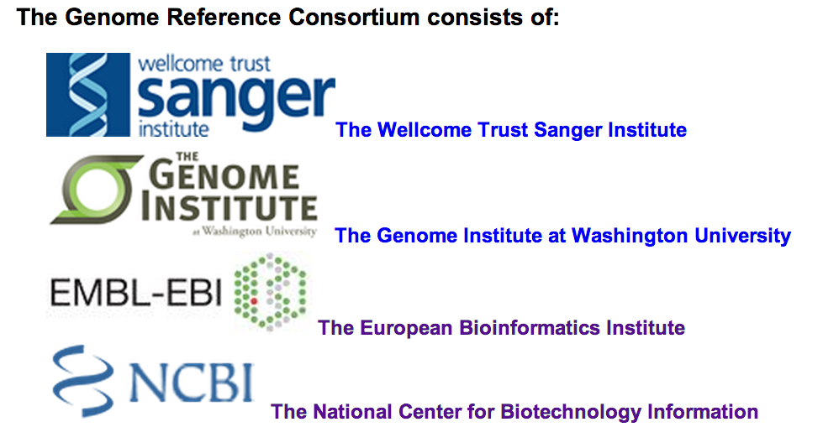
Valerie Schneider, NCBI
http://genomereference.org

Slide 3
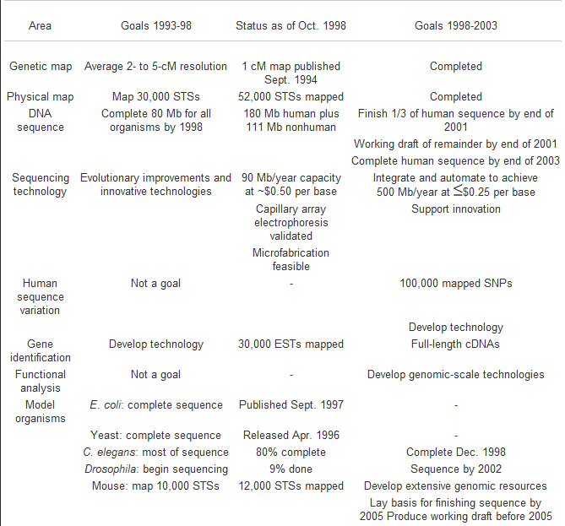
HGP Goals
Throughput: 500 Mb/year
Cost: < $0.25 per base
Variation: 100,000 SNPs mapped
Collins FS et al, 1998

Slide 4
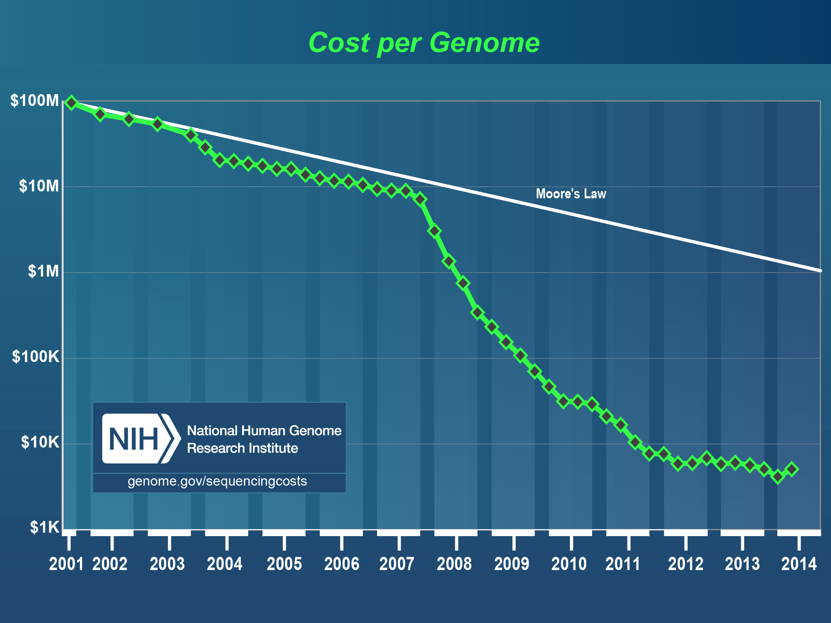

Slide 5
1999
2000
2005
2010
2011
Steve Sherry, NCBI

Slide 6
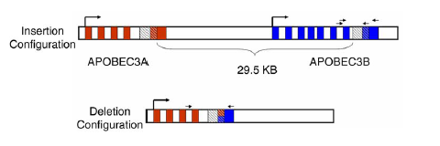
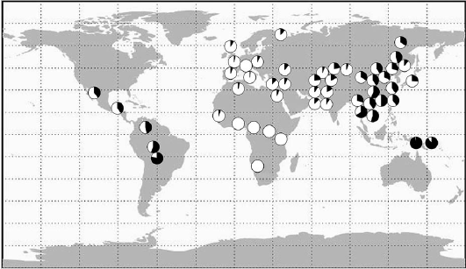
BLACK: Deletion
White: Insertion
Kidd et al, 2007 APOBEC cluster

Slide 7
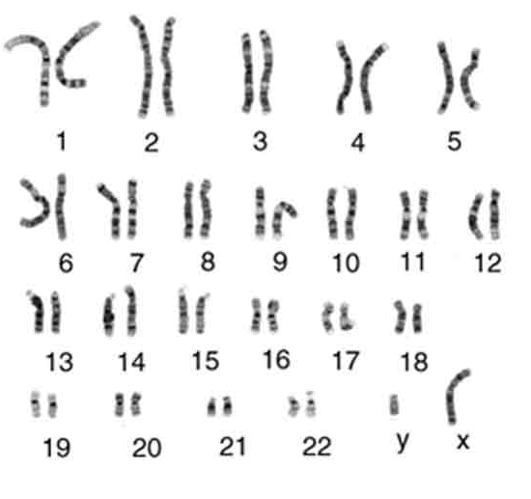

Slide 8
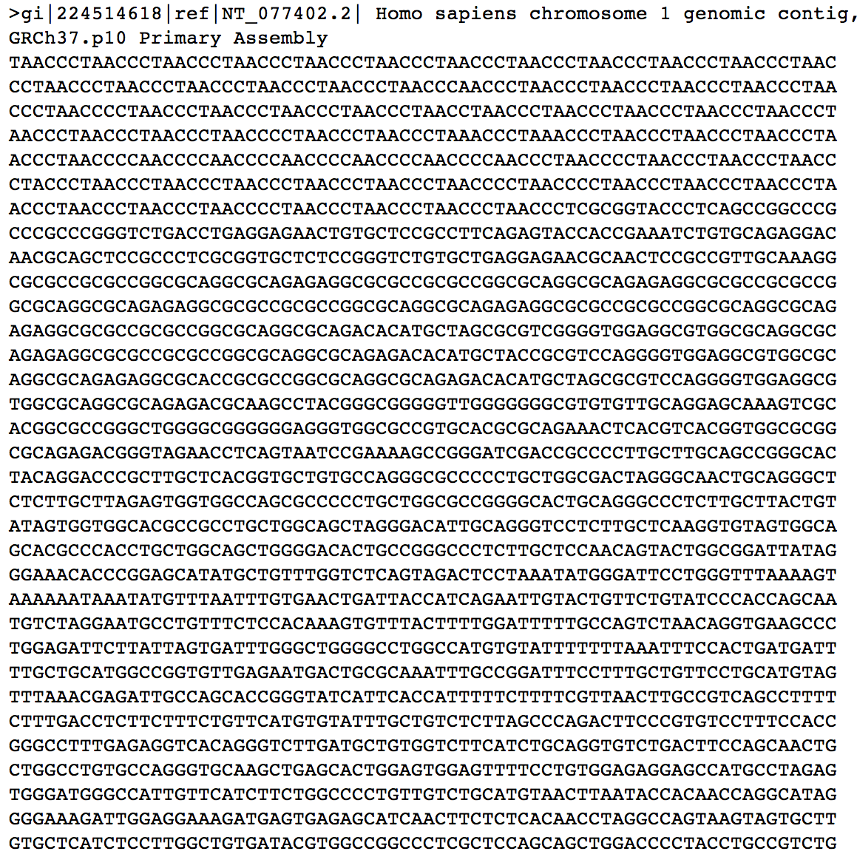


Slide 9

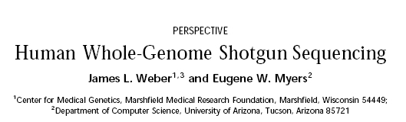
Reference assembly history
Genome Research, May, 1997
Notes:
Two types of data- Whole Genome and clone based. Two different types of assembly problems

Slide 10
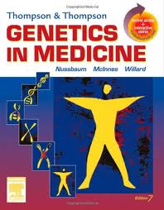




Slide 11
Reference assembly history
WGS: Sanger Reads
Restrict and make libraries
2, 4, 8, 10, 40, 150 kb
End-sequence all
clones and retain
pairing information
“mate-pairs”
Each end sequence
is referred to as
a read
Find sequence overlaps
tails
WGS contig
Scaffold

Slide 12
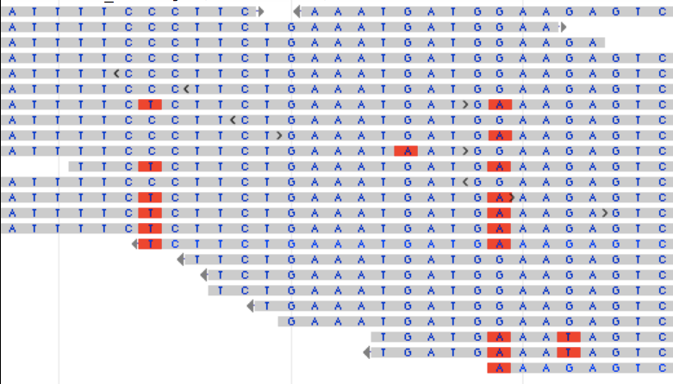
Reference assembly history
A T T T T C C C T T C T G A A A T G A T G A A A G A G T C
Notes:
Haplotypes blocks smaller unless you have good phasing.

Slide 13


Slide 14
Reference assembly history
Clone based assemblies
BAC insert
BAC vector
Shotgun sequence
deeper sequence
coverage rarely
resolves all gaps
Fold sequence
Assemble
Gaps
GAPS
“finishers” go in to manually
fill the gaps, often by PCR

Slide 15
Reference assembly history
Build sequence contigs based on contigs defined in TPF.
Check for orientation consistencies
Select switch points
Instantiate sequence for further analysis
Switch point
Consensus sequence
Notes:
Alignments refer to pairs of sequence. Once you know how a pair of sequences go together, you can look at stringing the pairs along into a contig. The contig is essentially the consensus sequence that is produced from the components.
To create a contig, we use the steps shown on this slide.
What are switch points? As you create the consensus sequence of the contig, the switch points tell you where to stop using the sequence from one component and begin using the sequence from the next.

Slide 16
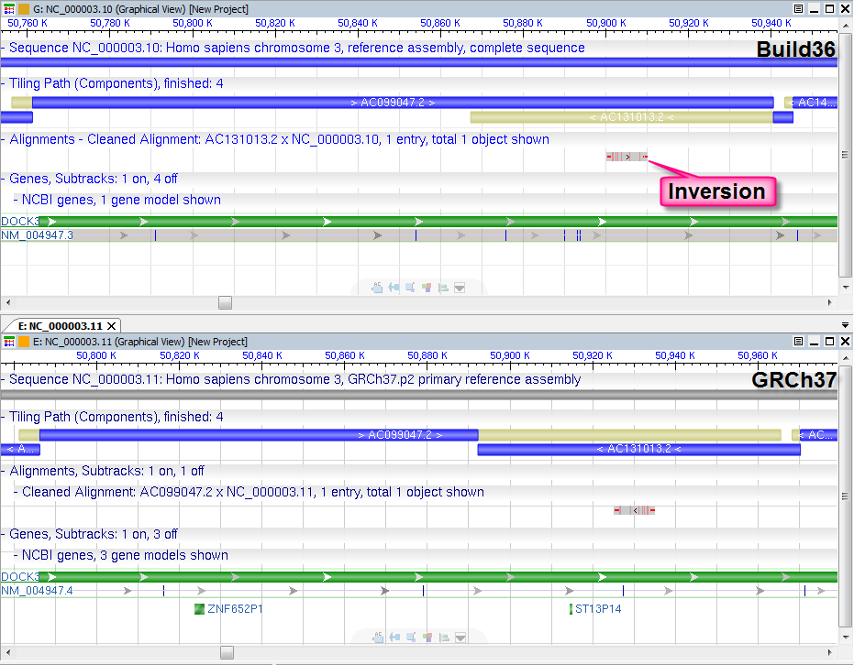
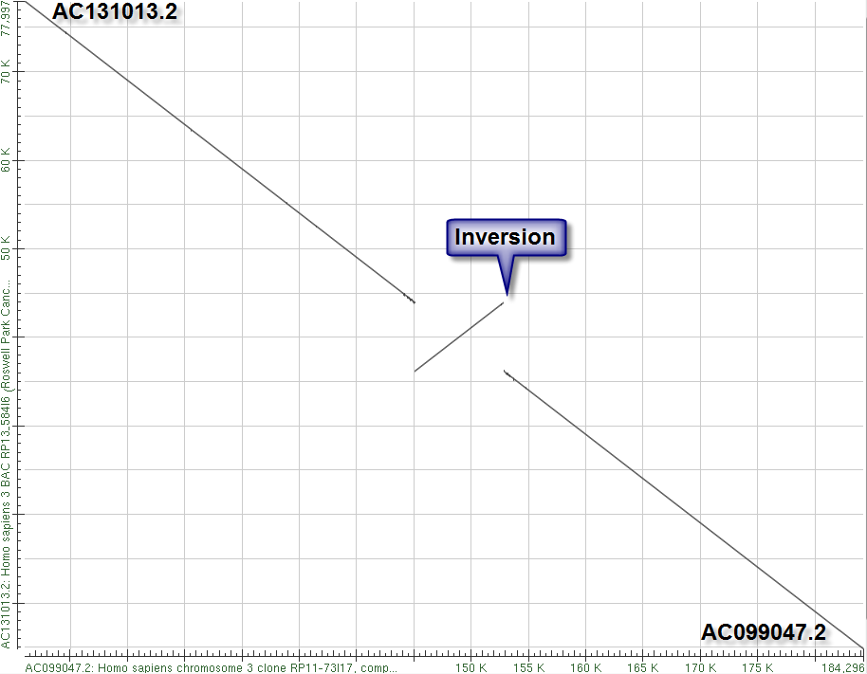
NCBI36
Notes:
Here’s a real-life example from human chromosome 3 where switch point selection is important.
Alignment has a red ball evaluation. Black marks suggest a problem in this region.
Looking at the alignment, can see there is an inversion within the alignment. Thus, there will definitely be different sequences, depending on where the assembly switch point is placed.
This turns out to be critical, because the alignment occurs within the DOCK3 gene. In Build 36, switch point occurred at the end of the first component. The GRC received a report from annotators that one of the exons of this gene was inverted. For GRCh37, the switch point was moved to the beginning of component 2, which corrected this problem.

Slide 17
Reference assembly history
Ideally…
A
B
A
C
F
B
G
D
H
C
E
D
K
F
L
G
H
A
F
I
G
B
J
H
C
K
K
D
L
L
M
O
O
N
N
(flip)
N
O
Non-sequence based Map

Slide 18
Reference assembly history
More like…
A
A
B
C
C
C
B
D
D
?
Y
Z
E
Y
F
X
A
A
G
W
B
B
H
H
H
H
I
J
I
I
J
J
J
V
K
L
L
M
L
M
M
M
N
N
N
O
N
O
O
O

Slide 19
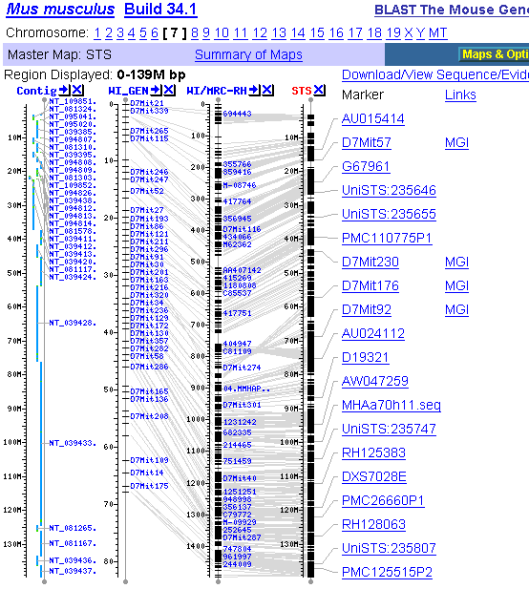
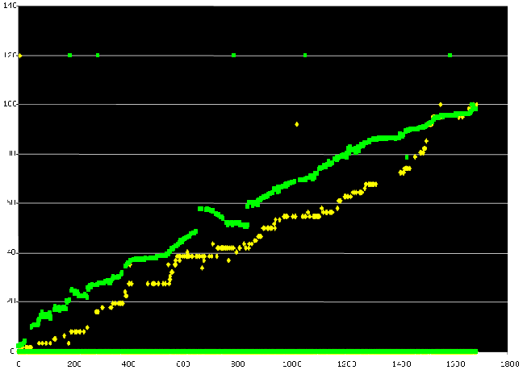
Sequence vs. Non-sequence based maps
Mmu7
WI Genetic
WI/MRC RH

Slide 20
RP11-34P13
64E8
RP4-669L17
RP5-857K21
RP11-206L10
RP11-54O7
Gaps

Slide 21
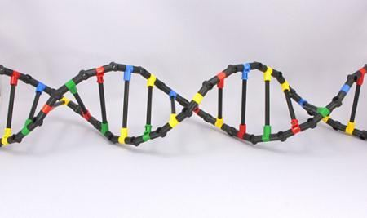
An assembly is a MODEL of the genome

Slide 22

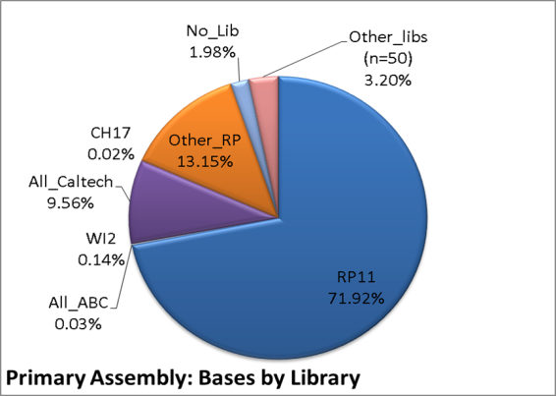
GRCh37

Slide 23
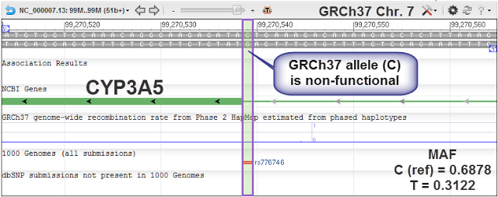
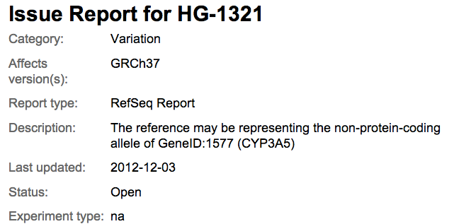
http://www.ncbi.nlm.nih.gov/projects/genome/assembly/grc/issue_detail.cgi?id=HG-1321

Slide 24
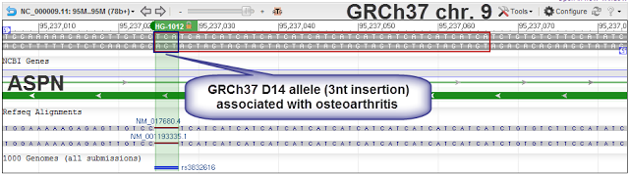
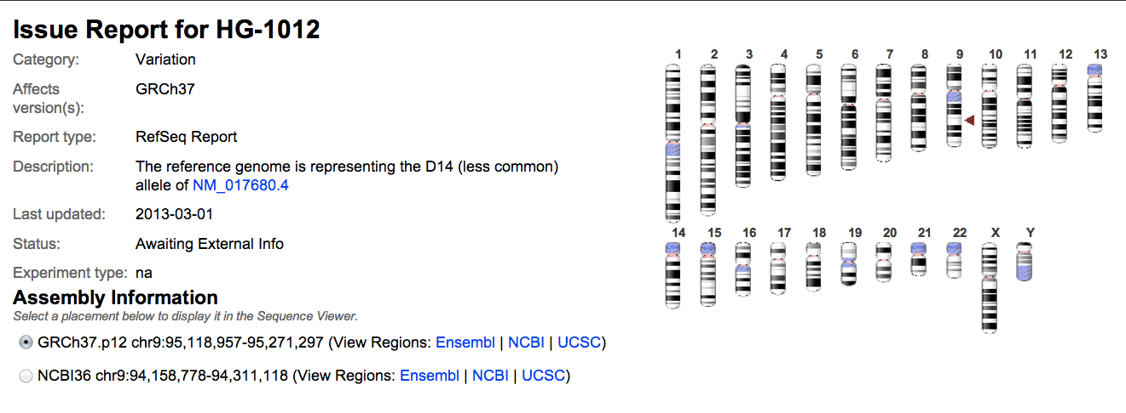
http://www.ncbi.nlm.nih.gov/projects/genome/assembly/grc/issue_detail.cgi?id=HG-1012

Slide 25
Center sequence distribution: NCBI36

Slide 26
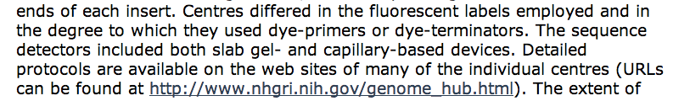

Finding the data

Slide 27
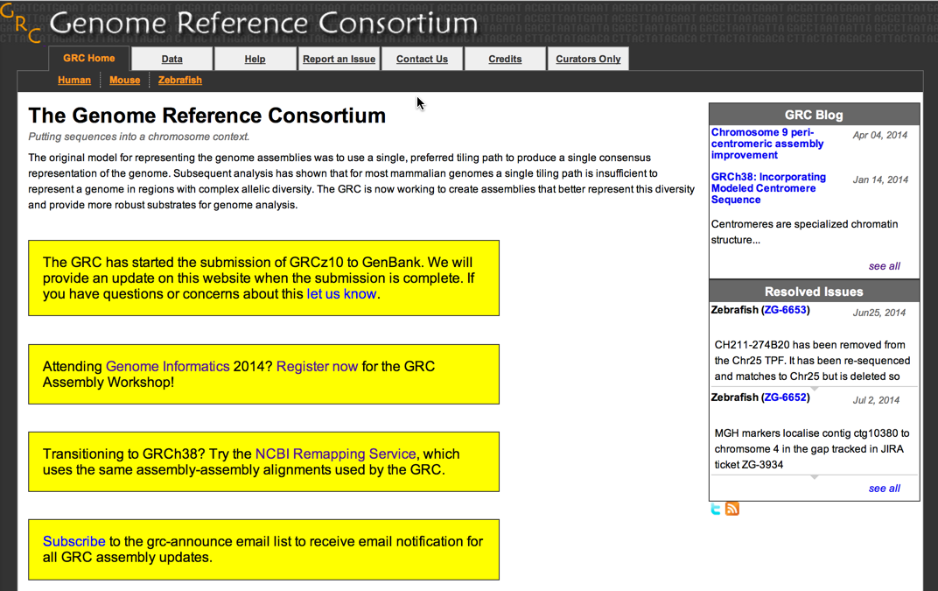

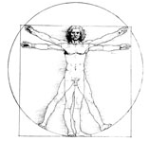
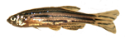
Church et al., 2011 PLoS
http://genomereference.org

Slide 28
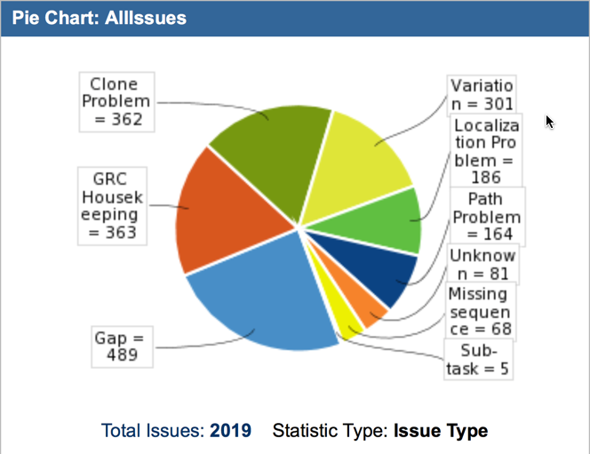

Slide 29
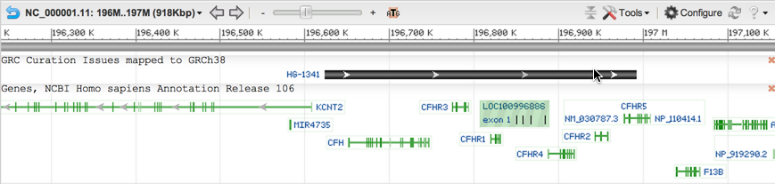
Finding Curated Regions: Browsers
NCBI: GRC Curation Issues mapped to $assembly_name
UCSC: GRC Incident Database
Ensembl: GRC_region_NCBI37

Slide 30
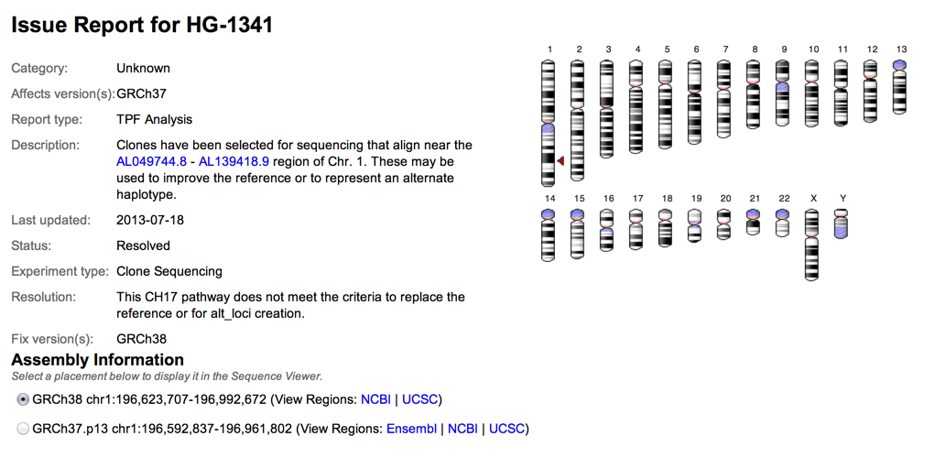
Finding Curated Regions: GRC web browser

Slide 31
Missing Sequence: Gaps
Sample genome
Duplicon A
Duplicon B
x
x
Duplicon A
GRCh37
G>A (allelic difference – true variant)
G>C (paralogous sequence variant- false positive)
May or may not detect increased coverage depending on sequencing depth and library quality (easier to find with new technologies than with old, low through technologies)

Slide 32
Missing sequence: collapse
Sample genome
Duplicon A
Duplicon B
x
x
Duplicon A
GRCh37
G>A (allelic difference – true variant)
G>C (paralogous sequence variant- false positive)
May or may not detect increased coverage depending on sequencing depth and library quality (easier to find with new technologies than with old, low through technologies)

Slide 33
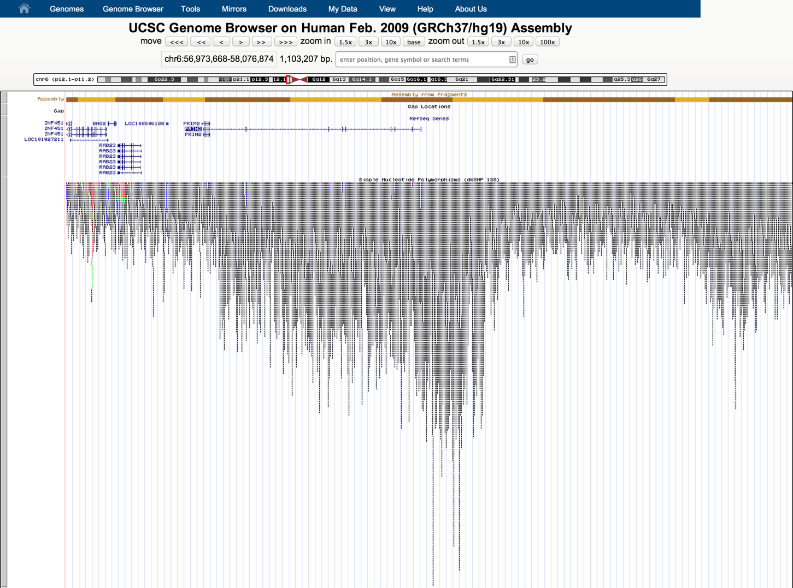
Missing paralogs in GRCh37

Slide 34
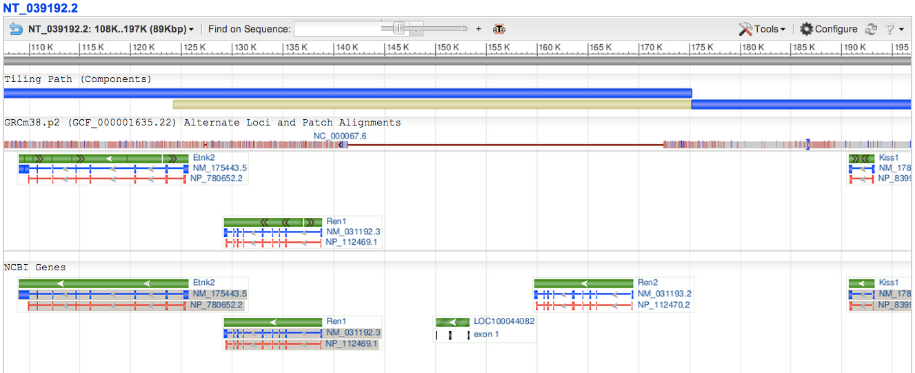
Mouse Ren1 chr1 (CM000994.2/NC_000067.6): 133350674-133360320
129S6/SVEvTac tiling path
Alignment to C57BL/6J chr1
+ 32Kb in 129S6/SvEvTac
B6 Genes
129S6/SvEvTac Genes

Slide 35
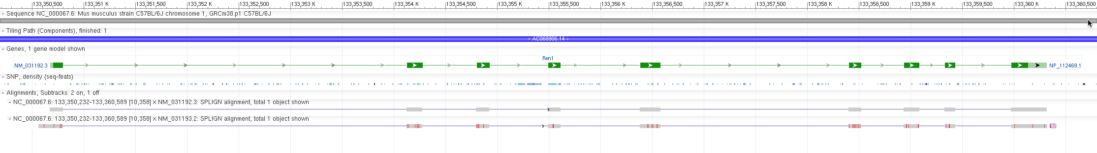
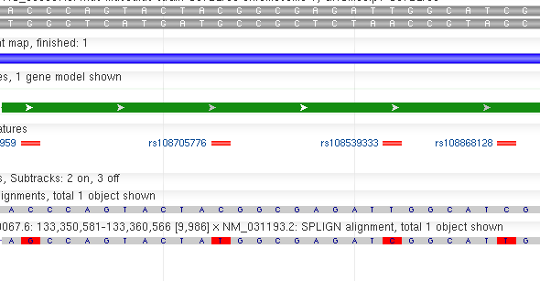
Mouse Ren1 chr1 (CM000994.2/NC_000067.6): 133350674-133360320
NM_031192.3: transcript from C57BL/6J
NM_031193.2: transcript from FVB/N
129S6/SvEvTac Alt Locus Alignment (allelic)
FVB/N Transcript Alignment (paralog)
Notes:
44 SNVs between Ren2 Tx alignment and Primary, 29 of these have rsIDs: of these, 19 Alt base = Ref (likely paralog diff and no evidence for polymorphism), 9 Alt base = Tx base (SNP and Parolog diff?), 1 Alt base != Ref and Alt base != Tx (craziness)

Slide 36
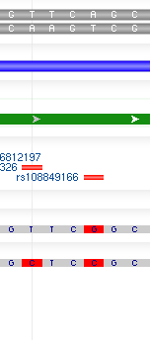
Mouse Ren1 chr1 (CM000994.2/NC_000067.6): 133350674-133360320
NM_031192.3: transcript from C57BL/6J
NM_031193.2: transcript from FVB/N
129S6/SvEvTac Ren1
FVB Ren2 Tx
Paralogous
diff
SNP + Paralogous diff

Slide 37
Sequences from haplotype 1
Sequences from haplotype 2
Old Assembly model: compress into a consensus
New Assembly model: represent both haplotypes

Slide 38
NCBI36 NC_000004.10 (chr4) Tiling Path
nsv532126 (nstd37)
AC079749.5
AC147055.2
AC019173.4
AC021146.7
AC074378.4
AC134921.2
AC140484.1
AC093720.2
TMPRSS11E
TMPRSS11E2
GRCh37 NC_000004.11 (chr4) Tiling Path
AC079749.5
AC147055.2
AC021146.7
AC074378.4
AC134921.1
AC093720.2
TMPRSS11E
GRCh37: NT_167250.1 (UGT2B17 alternate locus)
AC019173.4
AC021146.7
AC074378.4
AC226496.2
AC140484.1
TMPRSS11E2
Xue Y et al, 2008

Slide 39
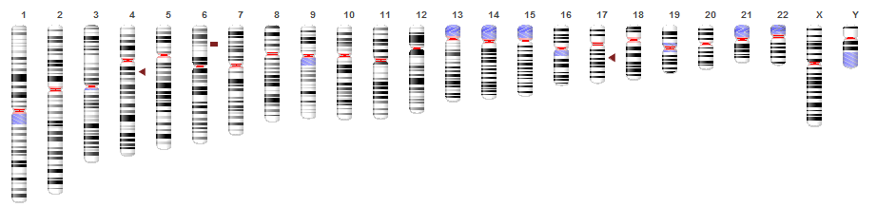
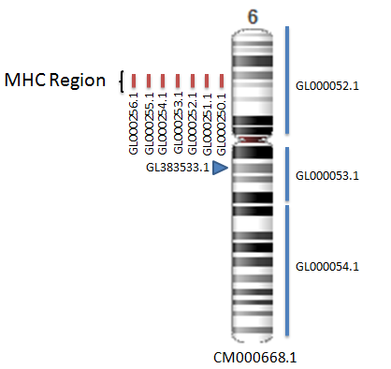
GRCh37 (hg19)
UGT2B17
MHC
MAPT
7 alternate haplotypes at the MHC
Alternate loci released as:
FASTA
AGP
Alignment to chromosome
http://genomereference.org

Slide 40

Updating the assembly
Oh No! Not a new version of the human genome!

Slide 41
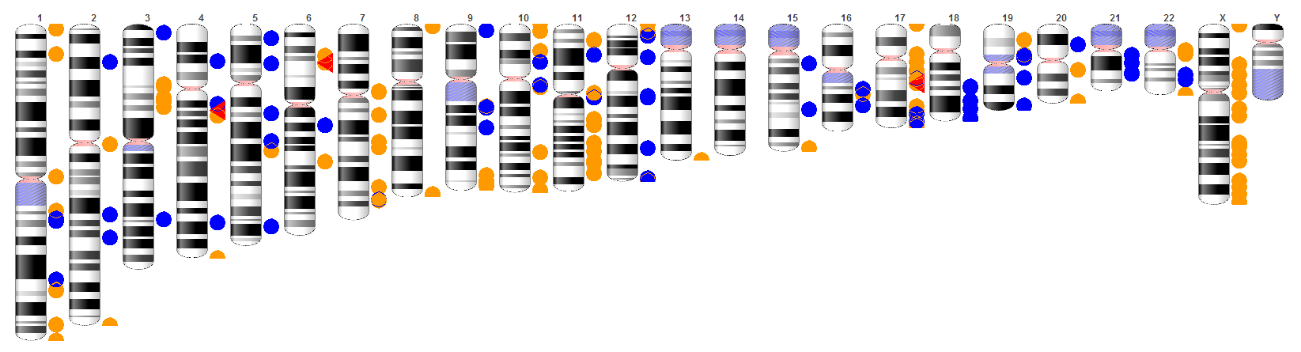
GRCh37.p13
(160 regions: >3% of chromosomes)
120 Fix PATCHES: Chromosome update in GRCh38
(adds >5 Mb of novel sequence to the assembly)
71 Novel PATCHES: Additional sequence added
(adds >800K of novel sequence to the assembly)
Releasing patches quarterly
Notes:
The GRC releases patches to the human assembly on a quarterly cycle. There are two varieties of patches:
FIX patches correct existing assembly problems: chromosome will update, patches integrated in GRCh38
NOVEL patches add new sequence representations: will become alternate loci
Approximately 3% of the current public human assembly GRCh37 is associated with a region that is represented by a patch or alternate locus.
As you can see, the GRC has been very busy with updating assemblies. I’d now like to talk about the tools and software we use to do this.

Slide 42
Data Model
Assembly (e.g. GRCh37.p5)
PAR
Non-nuclear assembly unit (e.g. MT)
Primary
Assembly
ALT
1
ALT
2
ALT
3
Genomic
Region
(MHC)
ALT
4
ALT
5
ALT
6
Genomic
Region
(UGT2B17)
Genomic
Region
(MAPT)
ALT
7
ALT
8
Genomic
Region
(ABO)
Genomic
Region
(SMA)
ALT
9
Genomic
Region
(PECAM1)
Patches
…

Slide 43
Data Model
GCA_000001405.6
/GCF_000001405.17
ALT
4
GCA_000001345.1/
GCF_000001345.1
Primary
Assembly
GCA_000001305.1/
GCF_000001305.13
ALT
5
GCA_000001355.1/
GCF_000001355.1
ALT
6
GCA_000001365.1/
GCF_000001365.2
Non-nuclear assembly unit (e.g. MT)
GCA_000006015.1/
GCF_000006015.1
ALT
7
GCA_000001375.1/
GCF_000001375.1
ALT
1
GCA_000001315.1/
GCF_000001315.1
ALT
8
GCA_000001385.1/
GCF_000001385.1
ALT
2
GCA_000001325.1/ GCF_000001325.2
ALT
9
GCA_000001395.1/
GCF_000001395.1
ALT
3
GCA_000001335.1/
GCF_000001335.1
GCA_000005045.5
GCF_000005045.4
Patches

Slide 44
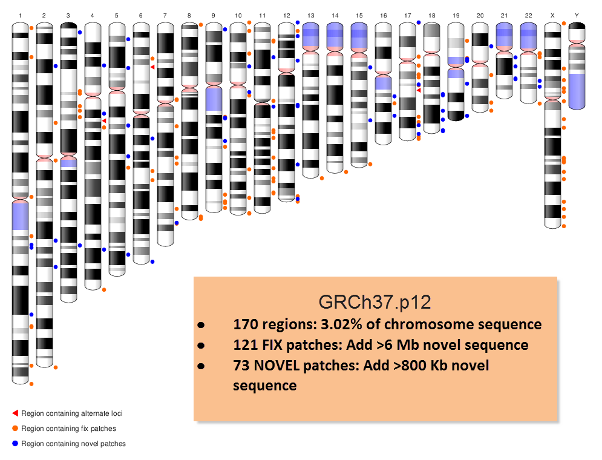
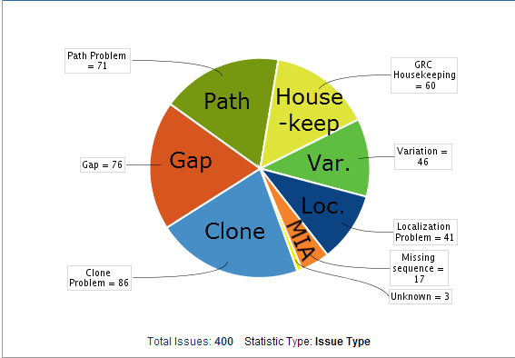
Human Resolved for GRCh38
http://genomereference.org
Notes:
The reference is not just the is the chromosome sequences of the primary assembly unit, but also includes the alternate loci and patches, which are used to provide additional sequence representations at selected genomic regions.
The GRC has been releasing patches to the human assembly on a quarterly cycle, and we’re now at GRCh37.p12. There are two varieties of patches:
FIX patches correct existing assembly problems: chromosome will update, patches integrated in GRCh38
NOVEL patches add new sequence representations: will become alternate loci
This ideogram shows the current distribution of patches and alternate loci, and you can see that many regions have changed since GRCh37. Note that approximately 3% of the current public human assembly GRCh37 is associated with a region that is represented by a patch or alternate locus.

Slide 45

GRCh38 is here!
(Dec, 2013)

Slide 46
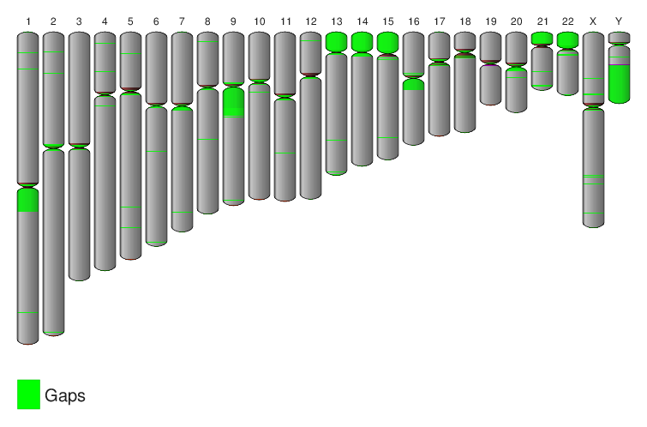
Reference Genomes Aren’t Finished
GRCh38

Slide 47
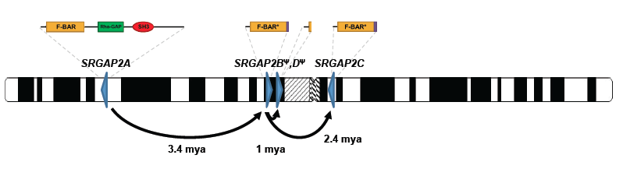
1q32
1q21
1p21
1p21 patch alignment to chromosome 1
Dennis et al., 2012
Notes:
Look up how much novel sequence added
Across all patches: 35 Mb of sequence added

Slide 48
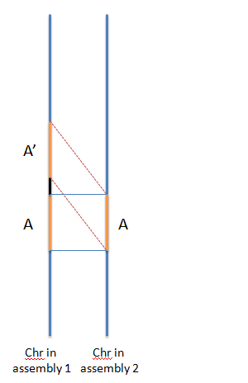
Migrating to GRCh38
First Pass + Second Pass = Collapse
Second Pass Only = Expansion
B
B
First Pass Alignments
NCBI Remap tool
Second Pass Alignments
First Pass Alignments
http://www.ncbi.nlm.nih.gov/genome/tools/remap

Slide 49
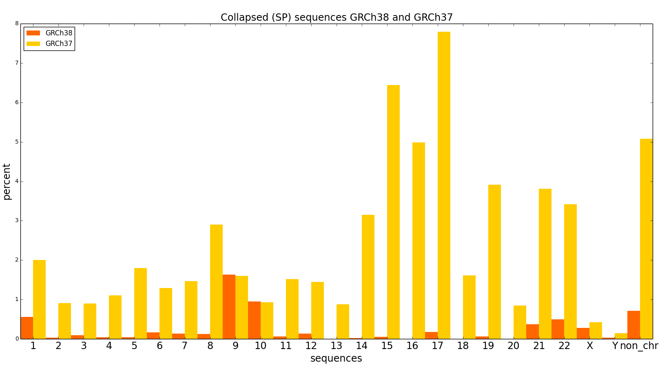
Migrating to GRCh38
Collapsed Sequence by Assembly
GRCh38
GRCh37

Slide 50
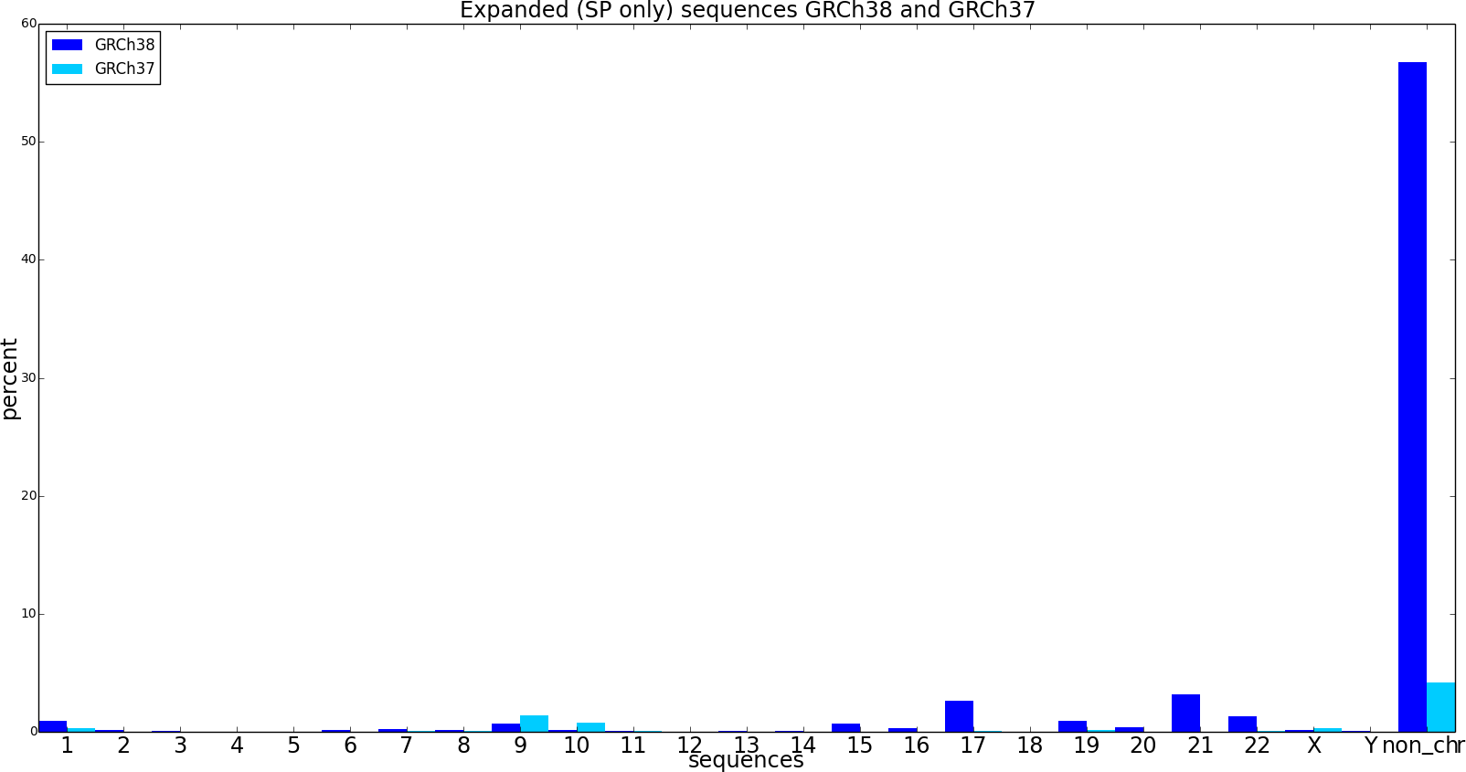
Migrating to GRCh38
Expanded Sequence by Assembly
GRCh38
GRCh37

Slide 51
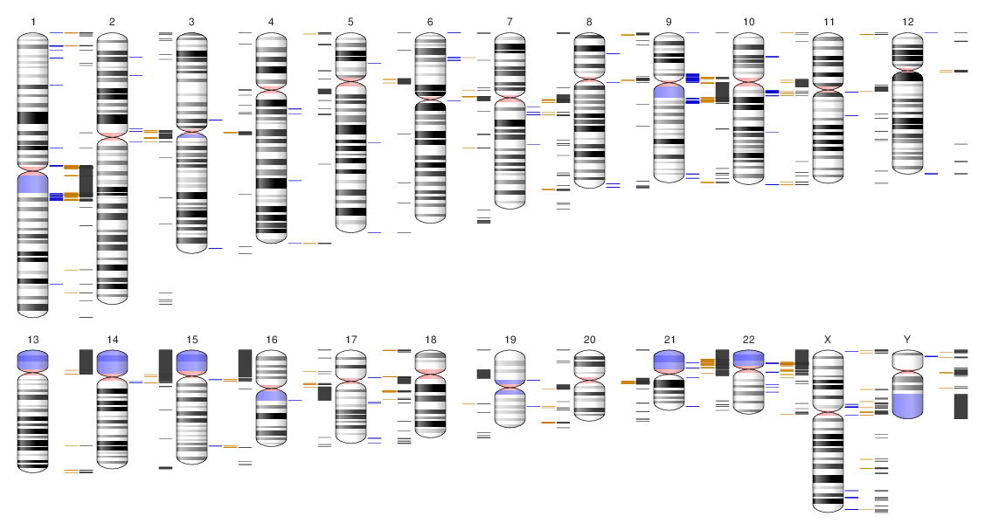
Migrating to GRCh38
GRCh38 collapse vs. GRCh37
GRCh38 expansion vs. GRCh37
GRCh38 no alignment vs. GRCh37

Slide 52
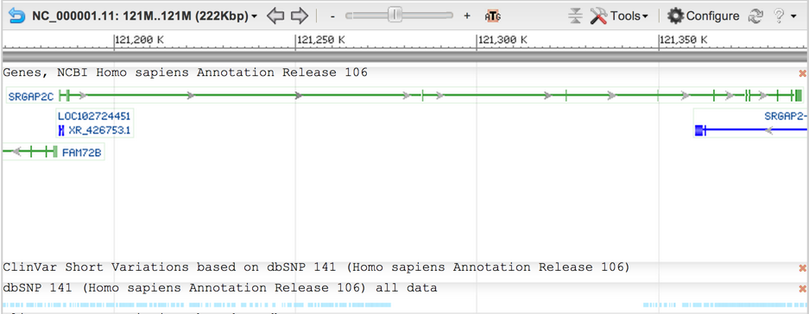
Migrating to GRCh38
GRCh38 annotation (NCBI)
No dbSNP 141 variants

Slide 53
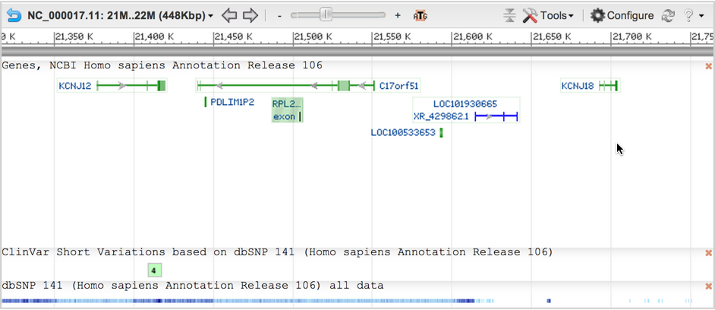
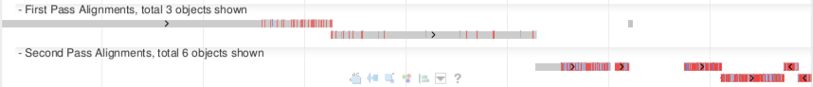
Migrating to GRCh38
First Pass remap
Second Pass remap
Notes:
Susceptibility to thyrotoxic periodic paralysis

Slide 54
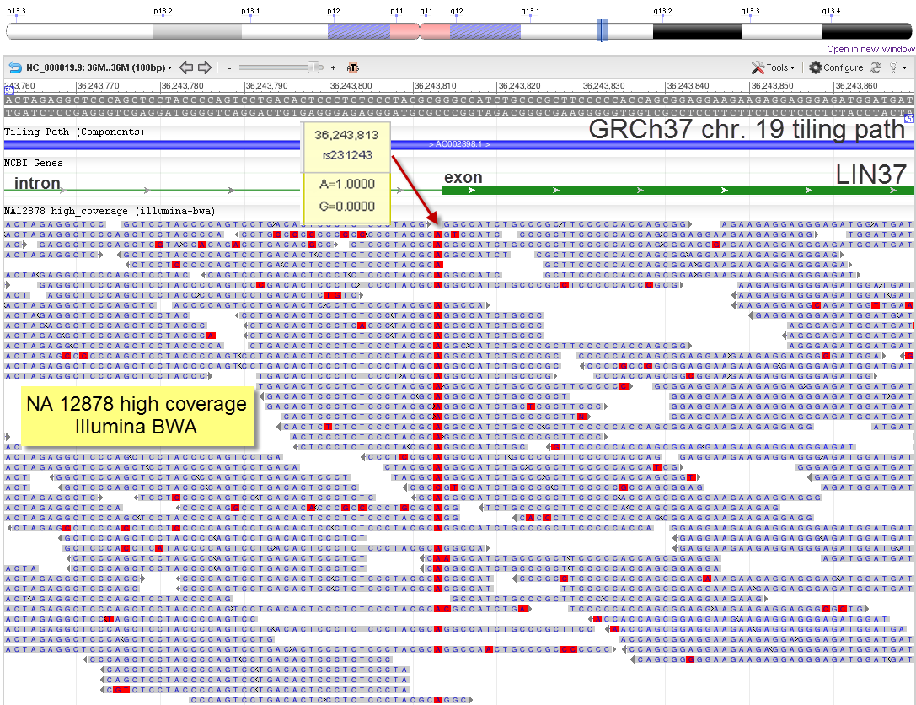
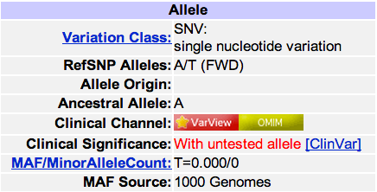
Fixing Rare/Incorrect Bases
Notes:
For the intermediate build GRCh37B, we are updating a subset of the high-confidence bases, about 1000, as our proof-of-principle. This panel shows reads from NA12878 aligned to chr. 19 that identify a base with MAF=0 in the LIN37 locus. This creates a non-consensus splice site.
To create accessioned sequence for correcting the reference, we are using cortex_con (Iqbal and Caccamo) to generate mini-contigs (>= 50 bp) from collections of 1kG and RP11 WGS reads, the former selected from random 1kG populations.

Slide 55
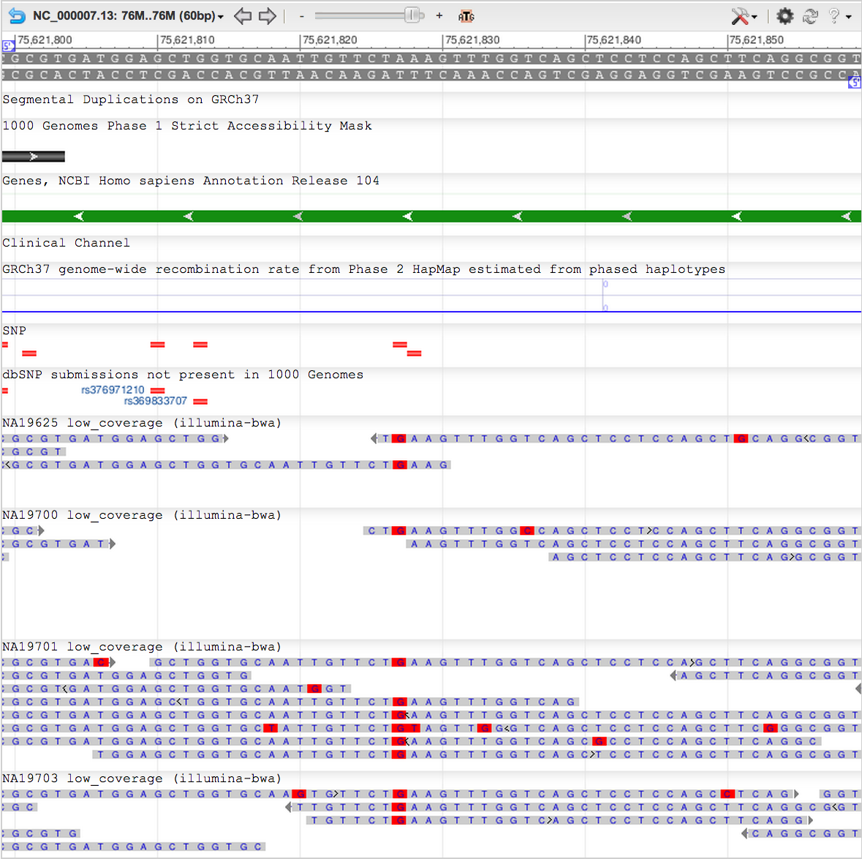
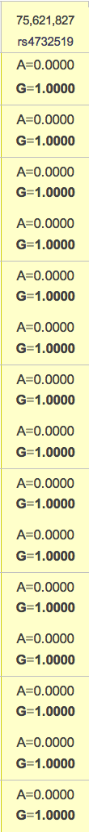
A = 0.000
G=1.000
rs4732519

Slide 56

RP11 WGS reads
Private RP11 variant?
Missing in 1000G?
rs4732519

Slide 57

FAM23_MRC1 Region, chr10
Segmental Duplications
1KG accessibility Mask
Novel Patch
250 kb of artificial duplication

Slide 58

Genovese et al., 2013

Slide 59

Adding Novel Sequence
Notes:
Adding NOVEL sequence for GRCh38 doesn’t just mean adding sequence that is completely unrepresented in GRCh37. While many of the NOVEL patches, like the one on the previous slide, represent indels, adding novel sequence also means adding sequence variants for regions too complex to be represented by a single path.
There is substantial variation at the LRC/KIR region on chr. 19. As shown on this slide, not only has the GRC replaced the GRCh37 path, which was derived from components from different clone libraries, with a single haplotype path from the CHM1 assembly, it also now has 8 different haplotypes represented as alternate loci. The addition of another 10+ haplotypes at this locus is also under consideration.

Slide 60

Migrating to GRCh38
GRCh38 Alternate Loci

Slide 61


Adding Novel Sequence
Karen Hayden and Jim Kent
Notes:
There are several mechanisms we can use for capturing decoy.
Much of the decoy represents centromeric repeat sequence. In collaboration with Karen Hayden in Jim Kent’s lab at UCSC, the GRC is planning to include modeled centromeric sequences in GRCh38.

Slide 62

Take home messages
The human and mouse reference assemblies are not linear single haplotype representations
Complex variation and segmental duplication makes genome assembly challenging.
This is true even using newer long read data
New assembly will challenge our understanding of annotation

